Slide 1
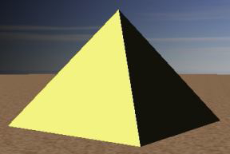
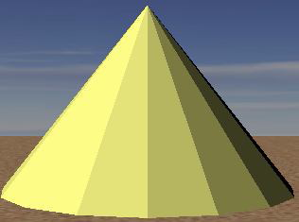
Introduction to 3D Graphics
Using OpenGL 3D

Slide 2
Classical Polygon Graphics (H/W) Pipeline
Mesh objects with 3D polygons (triangles or quads usually)
Apply material properties to each object
Texture-map polygons as needed
Light scene
Place camera
Render each polygon
Enjoy the view

Slide 3
Why OpenGL for 3D?
Widely used in industry and academia for interactive or real-time 3D graphics
Old fixed-function API (OpenGL 1.x) assisted rapid prototyping of simple 3D scenes with “classical” lighting effects
Experiment with simple ideas quickly
Modern programmable API allows for more flexibility and control
TAs will provide shaders to replace the fixed-function API functionality for projects/labs; you will write your own in Phong lab

Slide 4
3D Polygons (1/2)
Material specification
Describes the light reflecting properties of the polygon
Color, shininess, reflectiveness, etc.
Provided as input to shader
Provide values as uniforms to apply to entire shapes
Provide values as attributes to apply to individual vertices
// Pale yellow, opaque (alpha defaults to 1 in our shader)
glUniform3f(glGetUniformLocation(shaderID, “color”), 1.0, 1.0, 0.3 };

Slide 5
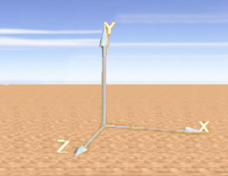
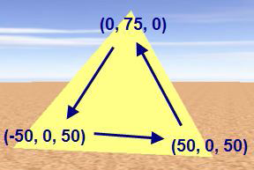
3D Polygons (2/2)
OpenGL defaults to a right-handed coordinate system
3D polygons are defined like 2D polygons: GLfloat vertexData[] = {
0, 75, 0, // Vertex 1
50, 0, 50, // Vertex 2
50, 0, 50, // Vertex 3
};
This defines one triangle
Coordinate values are arbitrary - can set virtual camera up to capture any size scene, so use convenient values
Remember counter-clockwise winding order!

Slide 6
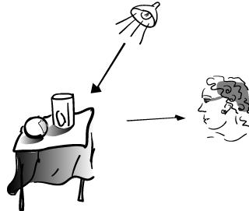
Complexities of Light Reflection from Surfaces – Need to Know
Intensity and direction of all light that strikes a point on object's surface, whether directly from light source or after many bounces from other objects ( global illumination)
How an object's surface appears to us as it reflects, absorbs, and diffracts light (“material properties”)
Location of eye/camera relative to scene
Distribution of intensity per wavelength of incident light
Human visual system (HVS) and its differential, highly non-linear response to light stimuli
Lights may have geometry themselves
Standard lighting/illumination models address these complexities (except for HVS)

Slide 7
An Imperfect World – Model via Approximations
Classic lighting models (also called illumination or reflection models, not to be confused with shading models discussed later) developed at the dawn of raster graphics in early 70s.
Epicenter at University of Utah where Ivan Sutherland worked with David Evans
Spawned the Evans & Sutherland flight simulator (with graphics) business
Other pioneers:
Henri Gouraud (shading model – filling in interior pixels from colors at vertices of a triangle)
Bui Tuong Phong (lighting and shading models)
Martin Newell (the Utah teapot (SIGGRAPH icon), meshing algorithms)
James Clark (geometry engine, Silicon Graphics, Netscape)
John Warnock (Hidden Surface Elimination, Adobe)
Ed Catmull (splines, Pixar, Disney)
Alvy Ray Smith (SuperPaint, HSV color space, partnered with Catmull on LucasFilm -> Pixar)
etc...

Slide 8
An Imperfect World
Back then:
CPUs > 4 orders of magnitude less powerful, no GPU to speak of, just plot pixels
memory limited (measured in KB!)
Even on today's machines, a physically accurate light simulation requires computational power beyond the capabilities of supercomputers!

Slide 9
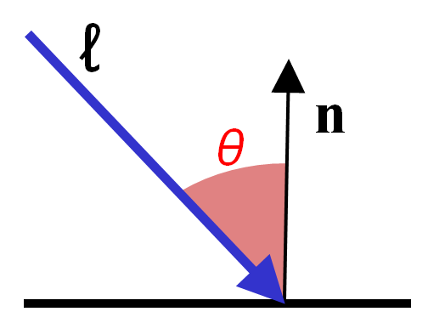
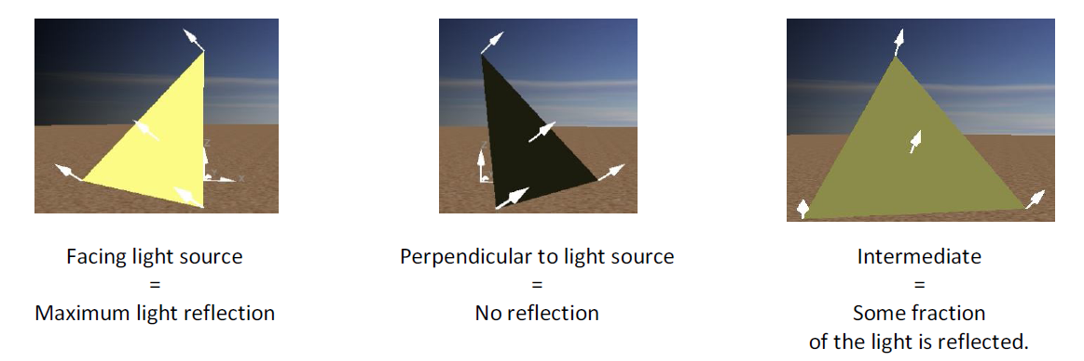
Lighting (Illumination) Models (1/2)
Color of point on surface dependent on scene lighting and surface material
First approximation: model diffuse reflection from a matte surface (light reflected equally in all directions, viewer-independent) based only on angle of surface normal to light source
Modeling light "drop-off“ with angle to light
Lambert's diffuse-reflection cosine law
for reflected light intensity I
I_{dir} = measure of intensity of directional light (all rays parallel) at point of contact with surface
θ = angle between surface normal (n) and vector from light source ( )
to light source:
No reflection
Facing light source:
Maximum reflection
Note: I_{dir} and all the other quantities in the lighting model are fractions between 0 and 1.
These units are convenient BUT completely arbitrary and not physically based!
In between: Some fraction of light reflected

Slide 10
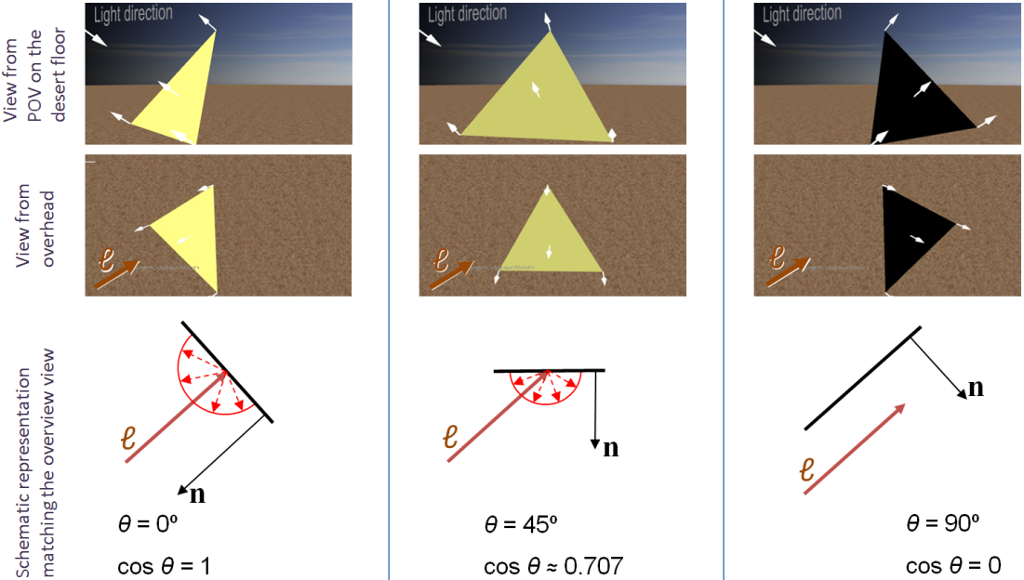
Lighting (Illumination) Models (2/2)
Lambert light attenuation based on surface's angle to light source
Visualization of Lambert's law in 2D
Note: we will crudely approximate the intrinsic material properties of the object with RGB values. For example, the greater the R, the more reddish the object will appear under white light.
In reality, need surface texture and wavelength-dependence

Slide 11
Shading Rule (1/6)
Goal: finding color at each pixel, preferably w/o having to evaluate a full lighting model at each pixel
First approach: Lambert's cosine law (flat/constant shading for whole facet)
faceted appearance, perfect for this rectangular pyramid.
What if we want to approximate a rounded object?
Lambert-shaded, faceted; appearance is no longer ideal
www.sklardevelopment.com/graftext/wpf/3d

Slide 12
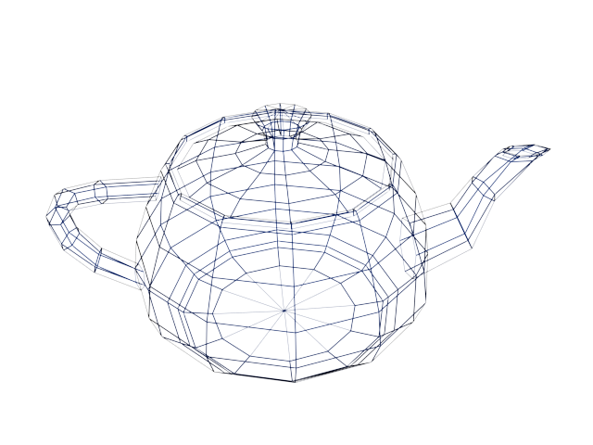
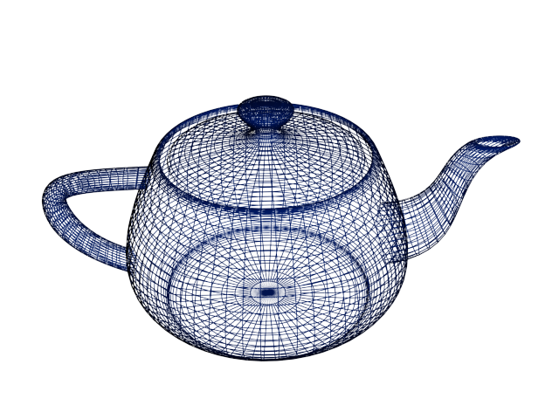
Shading Rule (2/6)
First solution: increase the number of polygons
Better shape approximation, more expensive to render
Ultimately, still faceted when rendered (higher poly count => less faceted)
Adaptive meshing is an improvement - more polygons in areas of high curvature
“Utah Teapot” by Martin Newell

Slide 13
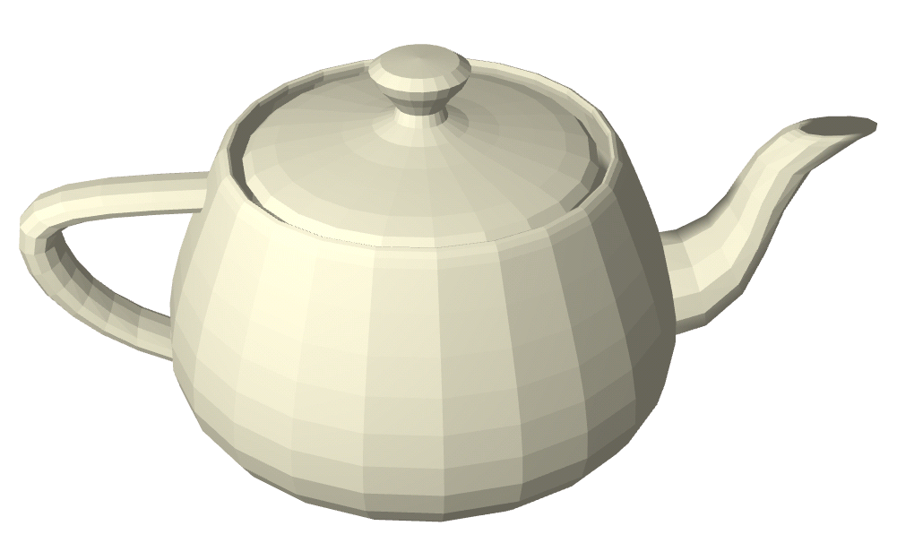
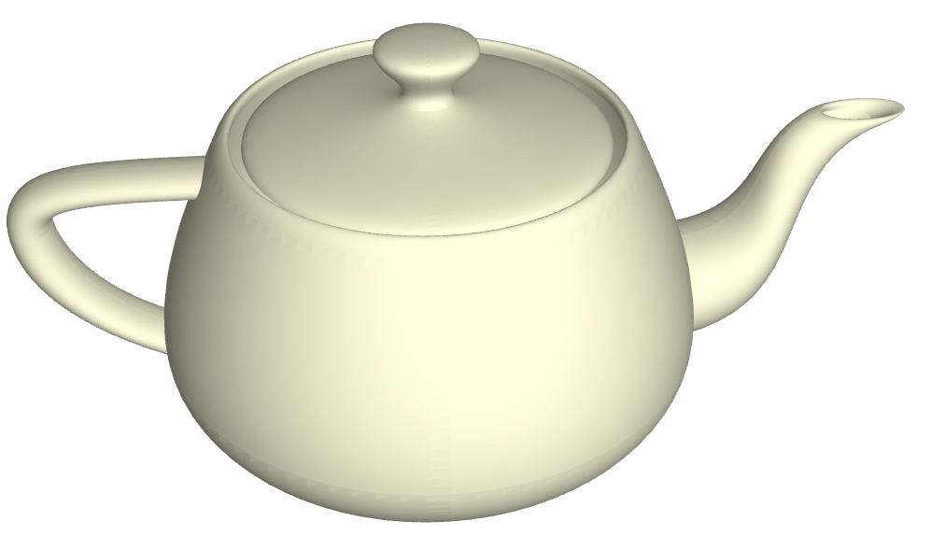
Shading Rule (3/6)
Get this:
Want this:
faceted shading
smooth shading

Slide 14
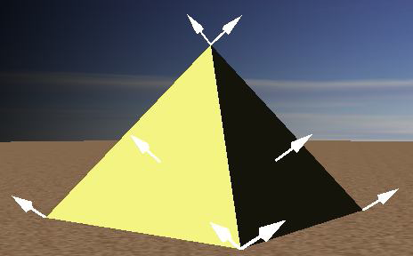
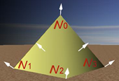
Shading Rule (4/6)
Gouraud smooth shading
compute lighting equation at each vertex of mesh
linearly interpolate vertex color values to get colors at all points
weighted averaging: the closer the point is to a vertex, the more it is influenced by that vertex
How do we determine vertex colors? Need a normal…
Vertex normals are an artifice; the normal is mathematically undefined since a vertex is a discontinuity
we hack around this by averaging
The normal at a vertex is the same as the plane normal. Therefore, each vertex has as many normals as the number of planes it helps define.
Faceted
Only one vertex normal per vertex; average of face normals of the faces the vertex is part of
Smooth

Slide 15
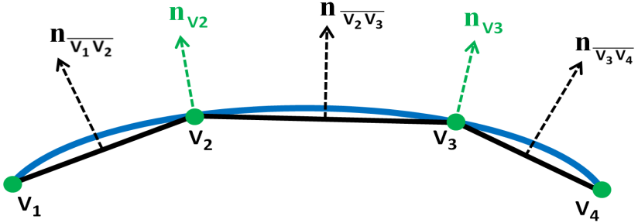
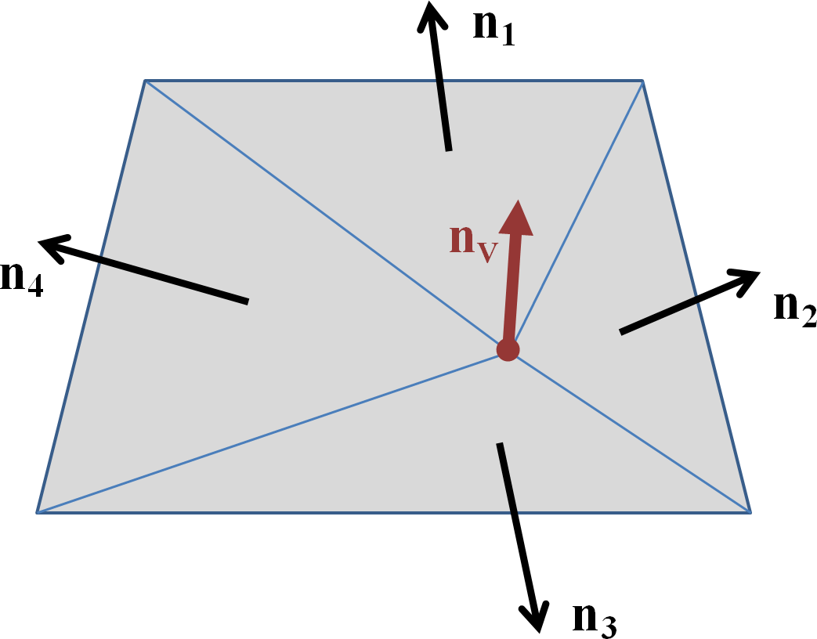
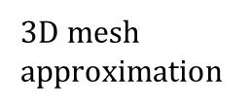
Shading Rule (5/6)
Vertex normals
if vertex used by only one face, normal is set to face's normal
typically computed from the plane equation
otherwise, normal is set to average of normals of all faces sharing it
if mesh is not too coarse, vertex normal is a decent approximation to the normal of modeled surface closest to that vertex
adaptive meshing adds more triangles in areas with rapid changes in curvature
2D curve approximation
(vertex normals in green)
Vertex normals shown in color, face normals in black
$3D$ mesh approximation

Slide 16
Shading Rule (6/6)
Programmable OpenGL API doesn’t provide any lighting or shading. Use shaders to implement lighting and shading model of your choice (We give you these for now).
to get flat shading, specify the same surface normal for vertices of the same facet (each vertex gets n normals, where n is the number of facets it is a part of)
to get smooth shading, you must specify a single shared normal for each (shared) vertex in the object
Faceted
Smooth

Slide 17
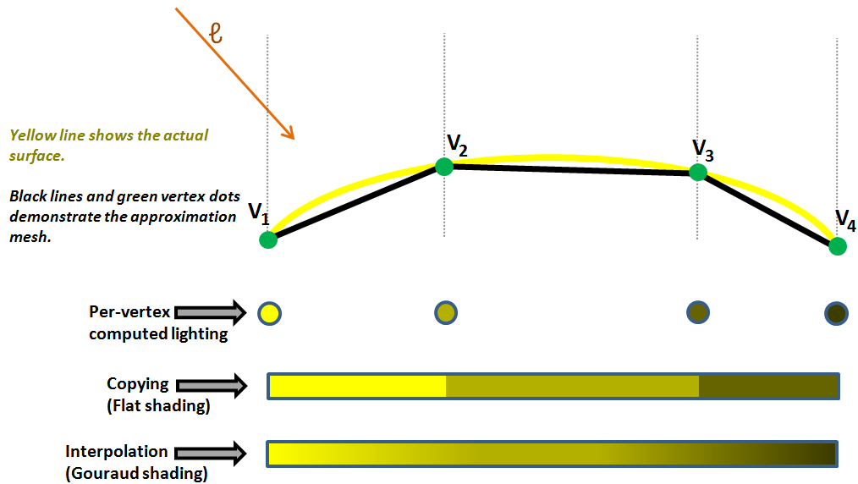
Interpolation vs Flat Shading Summary

Slide 18
Vertex Normals (1/2)
Sending vertex normal to the shader requires a small extension to the way we specify vertices
Each vertex is now a position plus a normal, e.g.,
GLfloat[] vertexData = {
-1, 0, 0, // Position 1
0, 0, -1, // Normal 1
1, 0, 0, // Position 2
1, 0, 0, // Normal 2
… };
Normals needn’t be axis-aligned, of course…
For flat shading a shared vertex has as many (position, normal) entries as the facets it’s a part of

Slide 19
Vertex Normals (2/2)
Enable the normal attribute
glEnableVertexAttribArray(<normal identifier>);
Make two calls to glVertexAttribPointer instead of one (like in 2D), one for positions and one for normals. We must adjust some parameters:
size parameter is now 3 since we have 3 elements per vector
stride specifies how far apart values of the same type (position/normal) are in our array (in bytes). Here stride is 6*sizeof(GLfloat) for both position and normal (the first element of each position/normal is 6 floats away from the next position/normal).
pointer is still (void*)0 for position, and is (void*)(3*sizeof(GLfloat)) for normals. First position starts 0 bytes into the array, first normal starts 3 floats into the array (use sizeof(GLfloat) to get bytes in a float) .
glDrawArrays(GL_TRIANGLES, 0, <number of tri’s>) replaces our 2D draw call. Now we’re drawing triangles instead of quads. Remember to bind the VAO before drawing and unbind it after.

Slide 20
VBOs and VAOs
VBO is a byte array, we’re only going to use GL_FLOAT when using the VBO, so we can think of it as a float array. Remember to use sizeof(GLfloat) when byte values are needed.
VAO holds our representation of the data
0
1
2
3
4
5
6
7
8
9
10
11
12
13
14
15
16
17
…
size (3)
Triangle 1
Position 1
Normal 1
Position 2
Normal 2
Position 3
Normal 3
0
1
2
3
4
5
6
7
8
9
10
11
12
13
14
15
16
17
…
Normal Pointer: (void *)(3*sizeof(GLfloat))
Position Pointer: (void *)0
Stride: (void *)(6*sizeof(GLfloat))

Slide 21
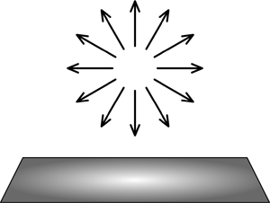
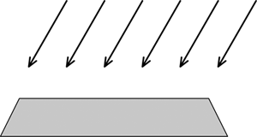

Reflectance (Illumination, Lighting) Model (1/8)
Non-geometric lights:
Ambient: crude approximation to inter-object (“global”) reflection, all surfaces receive same light intensity. Allows all facets to be minimally visible
Directional: illuminates all objects equally from a given direction; light rays are parallel (models sun, sufficiently far away)
Geometric lights:
Point: Originates from single point, spreads outward equally in all directions
Spotlight: Originates from single point, spreads outward inside cone’s directions
Directional
Point
Spotlight

Slide 22
Reflectance Model (2/8)
// ambient term is specified as RGB(A). Use glUniform4f to provide optional alpha value
glUniform3f(<Ambient Identifier>, 0.2, 0.2, 0.2 );
// vectors are XYZW quadruple, w = homogeneous coordinate (see Transformations lecture)
// if no need for homogenous coordinate, use glUniform3f instead
glUniform3f(<Position Identifier>, 10.0, 5.0, 8.0 );
glUniform3f(<Direction Identifier>, 1.0, 2.0, 3.0 );
// If our shader supports multiple types of lights, specify an integer constant to describe // type of light
glUniform1i(<Type Identifier>, POINT_LIGHT_TYPE);
// To use a directional light
glUniform1i(<Type Identifier>, DIRECTIONAL_LIGHT_TYPE);

Slide 23
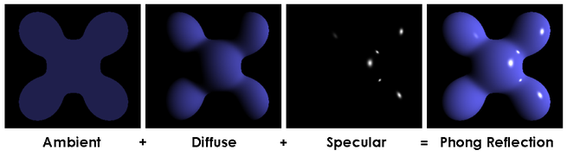
Reflectance Model (3/8)
Many models exist to approximate lighting physics – more accurate, more computation
Fixed-function OpenGL: Phong reflection model, survives today (though crude)
Implemented in fixed function hardware for decades, easily implemented in shaders
approximates lighting by breaking down into three components: ambient, diffuse, specular
can think of these as coincident, independent layers, each with its own characteristics, and sum them to get the final result
non-global illumination model – model does not handle inter-object reflections
AMBIENT Effect of light that is non-directional, affecting all surfaces equally.
 | + | DIFFUSE Effect of directional light on a surface with a dull/rough finish.
 | + | SPECULAR Effect of directional light on a shiny surface when the vector to the eye-point is closely aligned to the light’s reflected rays.
= | THE COMPOSITE The three independent reflectivity types are accumulated to produce the result.

Slide 24
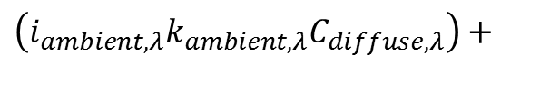
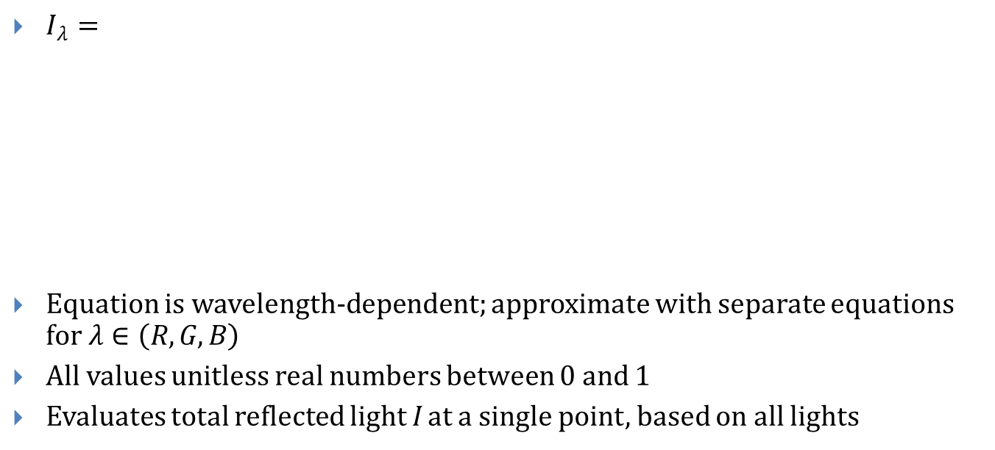
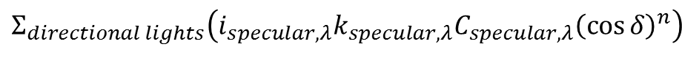
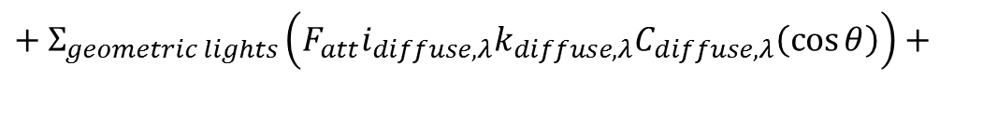
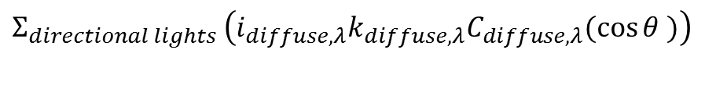
Reflectance Model (4/8)
$I_{λ}=$
Equation is wavelength-dependent; approximate with separate equations for $λ∈\left(R, G, B\right)$
All values unitless real numbers between 0 and 1
Evaluates total reflected light I at a single point, based on all lights
Ambient Component
$$\left(i_{ambient, λ}k_{ambient,λ}C_{diffuse,λ}\right)+$$
$$Σ_{directional lights }\left(i_{diffuse,λ}k_{diffuse,λ}C_{diffuse,λ}(\cos{θ} )\right)$$
Diffuse Component
$$+ Σ_{geometric lights}\left(F_{att}i_{diffuse,λ}k_{diffuse,λ}C_{diffuse,λ}\left(\cos{θ}\right)\right)+$$
Specular Component
$$Σ_{directional lights}\left(i_{specular,λ}k_{specular,λ}C_{specular,λ}{\left(\cos{δ}\right)}^{n}\right)$$
$$+Σ_{geometric lights}\left(F_{att}i_{specular,λ}k_{specular,λ}C_{specular,λ}{\left(\cos{δ}\right)}^{n}\right)$$

Slide 25
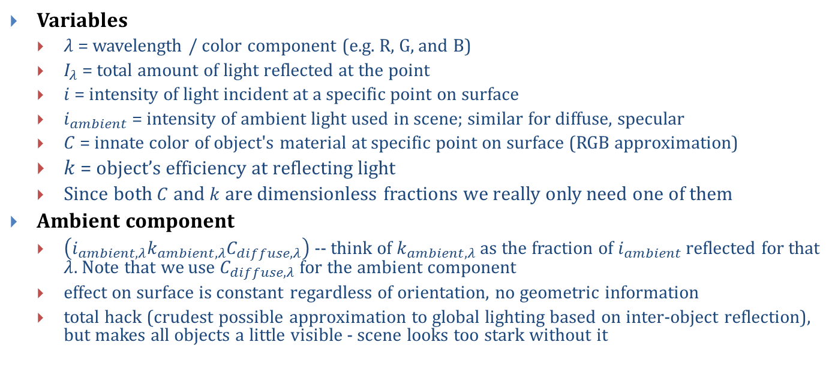
Reflectance Model (5/8)
Variables
$λ$ = wavelength / color component (e.g. R, G, and B)
$I_{λ}$ = total amount of light reflected at the point
$i$ = intensity of light incident at a specific point on surface
$i_{ambient}$ = intensity of ambient light used in scene; similar for diffuse, specular
$C$ = innate color of object's material at specific point on surface (RGB approximation)
$k$ = object’s efficiency at reflecting light
Since both $C$ and $k$ are dimensionless fractions we really only need one of them
Ambient component
$\left(i_{ambient,λ}k_{ambient,λ}C_{diffuse,λ}\right)$ -- think of $k_{ambient,λ}$ as the fraction of $i_{ambient}$ reflected for that $λ$. Note that we use $C_{diffuse,λ}$ for the ambient component
effect on surface is constant regardless of orientation, no geometric information
total hack (crudest possible approximation to global lighting based on inter-object reflection), but makes all objects a little visible - scene looks too stark without it

Slide 26
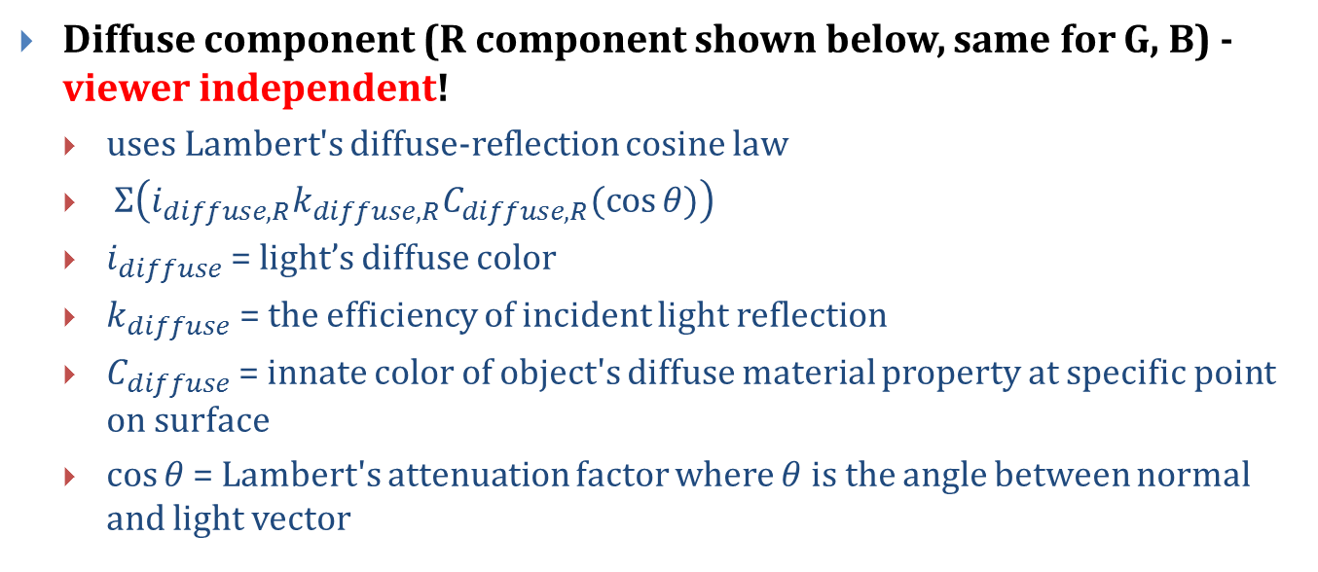
Reflectance Model (6/8)
Diffuse component (R component shown below, same for G, B) - viewer independent!
uses Lambert's diffuse-reflection cosine law
$Σ\left(i_{diffuse, R}k_{diffuse,R}C_{diffuse,R}(\cos{θ)}\right)$
$i_{diffuse}$ = light’s diffuse color
$k_{diffuse}$ = the efficiency of incident light reflection
$C_{diffuse}$ = innate color of object's diffuse material property at specific point on surface
$\cos{θ}$ = Lambert's attenuation factor where $θ$ is the angle between normal and light vector

Slide 27
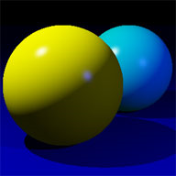
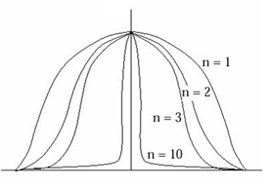
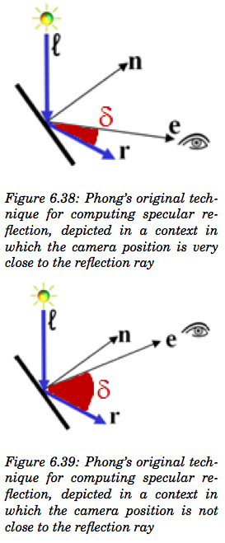
Reflectance Model (7/8)
$$Σ_{lights}\left(i_{specular,λ}k_{specular,λ}C_{specular,λ}{\left(\cos{δ}\right)}^{n}\right)$$
Specular Component (for R) – viewer-dependent
highlights seen on shiny objects (plastic, metal, mirrors, etc.)
cosine-based attenuation factor ensures highlight only visible if reflected
light vector and vector to viewer are closely aligned
n = specular power, how "sharp" highlight is – the sharper, the more intense
specular highlight of most metals are the color of the metal but those on plastic, shiny apple, pearl, etc. are mostly the color of the light (see Materials chapter 27)
e = viewpoint
r = reflected image of light source
ℓ = vector from the light source
n = surface normal
δ = angle between e and r
n = specular coefficient
Specular falloff of cos ^{n}
Note: Fixed-function OpenGL uses a slightly different lighting model called Blinn-Phong. See 14.9.3

Slide 28

Reflectance Model (8/8)
Attenuation factor
Used in diffuse and specular light calculation:
Directional lights have no attenuation (infinitely far away)
Geometric lights (point lights, spot lights) get dimmer with distance
Inverse square law
Area covered increases by square of distance from light
Thus, light intensity is inversely proportional to the square of the distance from light
A light twice as far away will be one quarter as intense
Though the physics say inverse square law, it doesn't always look good in practice so OpenGL lets you choose the attenuation function (quadratic, linear, or constant)
...$+ Σ_{geometric lights}\left(F_{att}i_{diffuse,λ}k_{diffuse,λ}C_{diffuse,λ}\left(\cos{θ}\right)\right)+$...
d
d
d

Slide 29
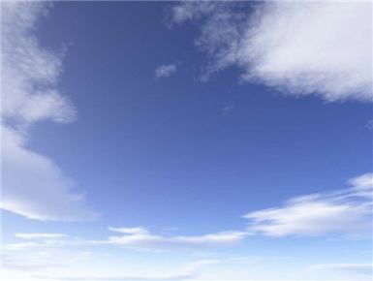
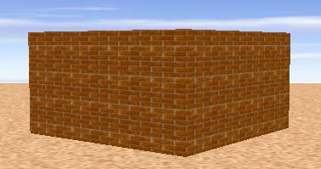
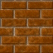
Texture Mapping (1/2)
Goal: adding more detail to geometry of scene without adding complexity
Solution: texture mapping
used extensively in video games, e.g., for backgrounds, billboards
also used for many other techniques such as level-of-detail management
cover the mesh's surface in stretchable "contact paper" with pattern or image on it
in general, difficult to specify mapping from contact paper to every point on an arbitrary 3D surface
mapping to planar polygons is easy: specify mapping for each vertex and interpolate to find mapping of interior points

Slide 30
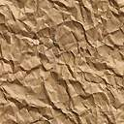
Texture Mapping (2/2)
Specifying "texture point" mapped to particular vertex
requires coordinate system for referring to positions within texture pixmap
convention:
points on pixmap described in abstract floating-point "texture-coordinate system"
axes labeled u and v, range 0 to 1.
origin located at the upper-left corner of the pixmap
(0,0)
U axis (1,0)
V axis
(0,1)

Slide 31
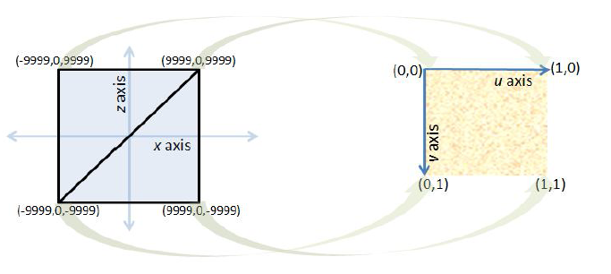
Texture Mapping UV Coordinates
Let’s map from two coplanar triangles from a face in the 3D model to a texture map
Texture map uses UV texture coordinates: just use ratios
Texture mapping arbitrary solids is much harder – we’ll study this later

Slide 32
Texture Mapping Example (1/2)
We add texture coordinates in the same way we added normals. For clarity we’ll leave out normals from this example.
First add the texture coordinate for each vertex to our data array
GLfloat[] vertexData = {
-10, 0, 0, // Position 1
0, 1, 0, // Normal 1
0, 0, // Texture Coordinate 1
10, 0, 0, // Position 2
0, 1, 0, // Normal 2
1, 0, // Texture Coordinate 2
… };

Slide 33
Texture Mapping Example (2/2)
Enable the texture coordinate attribute
glEnableVertexAttribArray(<texcoord location>);
Define texture coordinates like normals, except the glVertexAttribPointer parameters are slightly different.
size parameter is still 3 for positions and normals, now 2 for texture coords
stride is now 8*sizeof(GLfloat) for position, normal, and texture coordinate (because we have 8 floats per vertex instead of 6).
pointer is still (void*)0 for position, (void*)(3*sizeof(GLfloat)) for normal and (void*)(6*sizeof(GLfloat)) for texture coordinates (remember these values are in bytes).

Slide 34
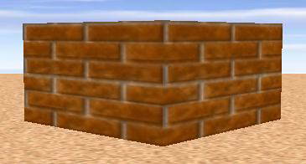
Texture Mapping (Tiling)
Create a brick wall by applying brick texture to plane
Produces realistic-looking image, but very few bricks in wall
Tiling increases number of apparent bricks

Slide 35
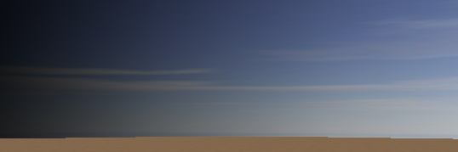
Texture Mapping (Stretching)
Create a sky backdrop by applying a sky image to a plane
Would look unnatural if tiled
Stretch to cover whole plane
Your texture shader can implement tiling and stretching by multiplying UV coordinates by a value >1 for tiling and <1 for stretching

Slide 36
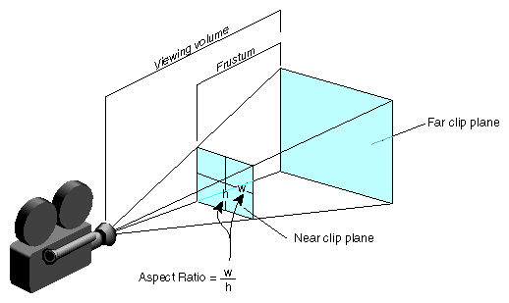
Camera (1/3)
Camera Properties:
Perspective or Orthographic
Position: placement of camera
Look Direction: direction camera is aimed (vector determining lens axis)
Up Direction: rotates camera about look vector, specifying which way is “up” – must not be collinear to the look vector
Far-Plane Distance: objects behind do not appear
Near-Plane Distance: objects in front do not appear
Field Of View: (Height Angle)
Aspect Ratio (Relative width and height)

Slide 37
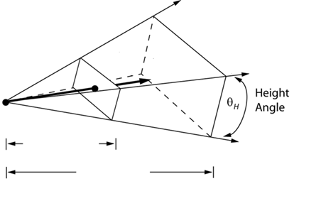
Camera (2/3)
Center of Scene
(used to compute LookAt Direction)
Perspective Projection
Projection of Up Direction
Up Direction
y
FOV in y-direction
Position
Near-Plane Distance
Far-Plane Distance

Slide 38
Camera (3/3)
Orthographic Projection
Width
Far distance
Center of scene
Height
Near distance
Projection of
up vector
Up vector
Position

Slide 39
OpenGL Camera
Fixed-function API has support for perspective and orthographic cameras
With the Programmable API you must construct and supply all model, view, and projection matrices, and then use them in your shaders
In the Viewing lectures you will learn how to construct these matrices yourselves and you will construct them in the Camtrans lab (We will take care of the camera until then)
In the shader labs you will learn how the matrices are used in the shader

Slide 40
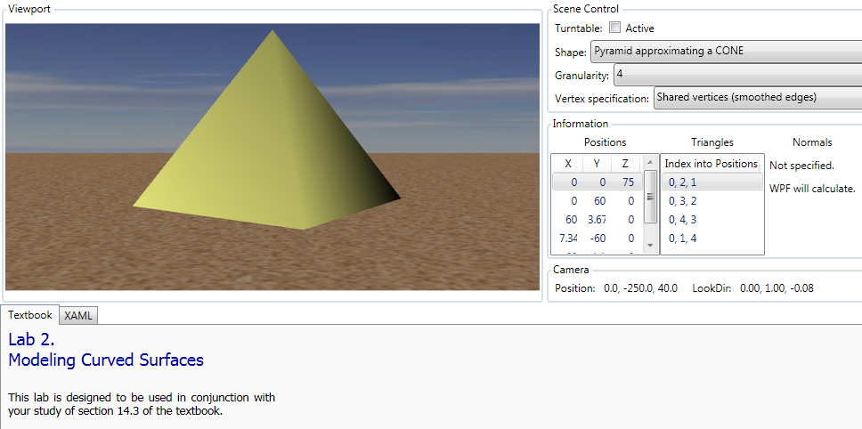
WPF3D Lablets (1/2)
Hands on exploration of concepts discussed in this lecture
Modeling smooth surfaces
www.sklardevelopment.com/graftext/wpf/3d

Slide 41
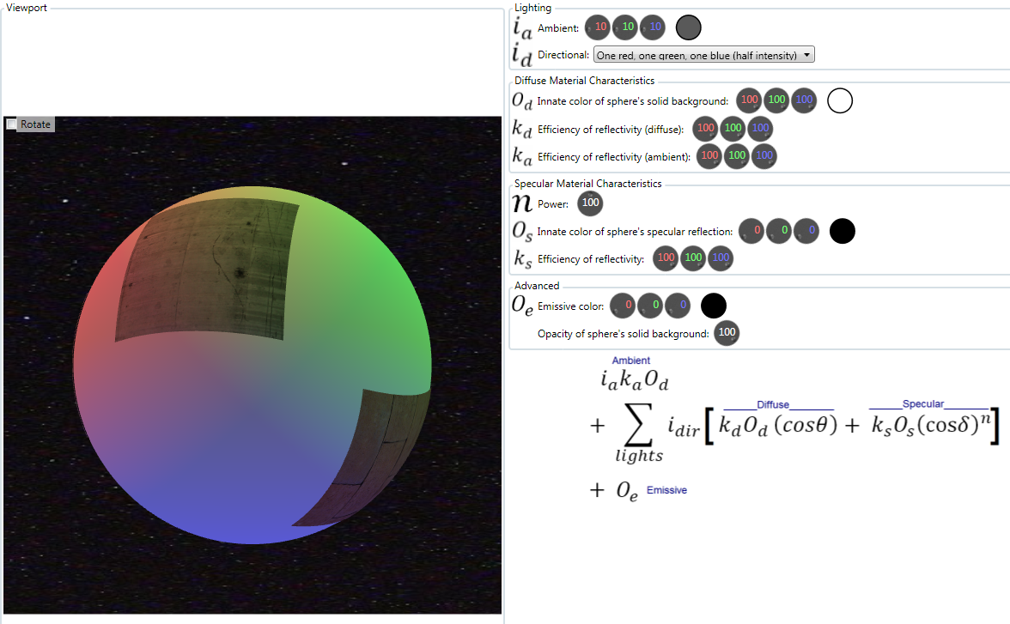
WPF3D Lablets (2/2)
Lighting and shading model
www.sklardevelopment.com/graftext/wpf/3d

Slide 42
Book Sections
Intro
Chapter 6

